Slide 1
LINKED OPEN DATA – an introduction
Elisabeth Robinson
EXPANIA 2014

Slide 2
Copyright Statement and Disclaimer
All of the information and material, including text, images, logos and product names, is either the property of, or used with permission by, Ex Libris Ltd. The information may not be distributed, modified, displayed or reproduced – in whole or in part – without the prior written permission of Ex Libris Ltd.
TRADEMARKS Ex Libris, the Ex Libris logo, Aleph, SFX, SFXIT, MetaLib, DigiTool, Verde, Primo, Voyager, MetaSearch, MetaIndex and other Ex Libris products and services referenced herein are trademarks of Ex Libris, and may be registered in certain jurisdictions. All other product names, company names, marks and logos referenced may be trademarks of their respective owners.
DISCLAIMER The information contained in this document is provided on an "AS IS" basis for general information purposes only without any representations or warranties, whether express or implied, including any implied warranties of satisfactory quality, completeness, accuracy or fitness for a particular purpose.
Ex Libris, and its subsidiaries and related corporations disclaim any and all liability for use of this information, even if advised of the possibility that loss, damage or expenses may arise.
© Ex Libris Ltd., 2014

Slide 3
Why Linked Data?
Where are our users looking for information?
Not in the library catalogue
80% of students started their search in a search engine
SOURCE: OCLC’S Perceptions of Libraries 2010
Only 16% started in the library catalogue
Credo Reference 2012

Slide 4
Remaining relevant
Value of library data is not disputed
But is it open?
MARC is a library standard
Need formats that can be used by others

Slide 5
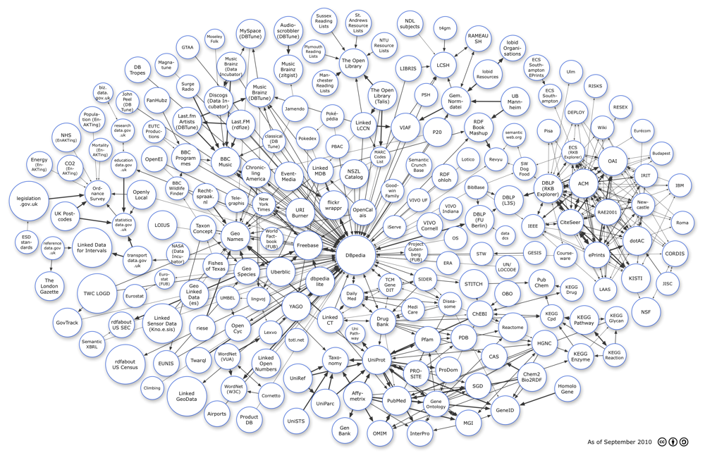
Collaboration, Openness, Extensibility
http://richard.cyganiak.de/2007/10/lod/
Linked Data describes a method of publishing structured data so that it can be interlinked and become more useful http://en.wikipedia.org/wiki/Linked_data
Linked Data has the potential to extend the level of sharing of knowledge between Libraries and external sources
Notes:
One of the promising technologies for extending our openness: Linked Data
A non-rigorous description of this could be:
Everything in the world is “linked”
In order for it work in real life application:
Everything must be uniquely identified (URI)
A way of accessing the data via an API
Best if many agree on how the API works (e.g. input and output)

Slide 6
What is linked data?
“describes a method of publishing structured data so that it can be interlinked and become more useful. It builds upon standard Web technologies such as HTTP and URIs, but rather than using them to serve web pages for human readers, it extends them to share information in a way that can be read automatically by computers. This enables data from different sources to be connected and queried.”
Source: http://en.wikipedia.org/wiki/Linked_data

Slide 7
¿Que es Linked Data?
‘..describe un método de publicación de datos, de una forma estructurada, para que estos puedan interrelacionarse y ser mas útiles. Se basa en tecnologías Web estándar como HTTP y URI, pero en vez de utilizarse para servir páginas web a lectores humanos, se usa para compartir información que pueda ser leída automáticamente por computadoras. Esto permite conectar los datos de diferentes fuentes. ‘’.
Fuente: http://en.wikipedia.org

Slide 8
Traditional Web
Source: http://www.slideshare.net/ITSToronto/linked-data-olita-2013
link
link
link
link
link
link
link
link
link
link

Slide 9
Linked Data
likes
works_for
authored
located_in
presented_at
knows
event_date
hosted_by
authored
works_for

Slide 10
We have a dream
Library data should be open

Slide 11
New scales
\\\\\\
2017
2 billion
Records?
2017
2013
2014
~100 searches per second
1 billion+ records
2014
2013
2007
50 searches per second
2007
5 million records
1 search per second

Slide 12
Big Data tools and techniques
Hadoop for massive bibliographic data processing
Increases processing capacity by a factor of 10 or more
New way of “job” data processing
Cassandra as core repository for item level data
Increases availability
Simplifies operations
Supports linear scalability
Notes:
In order to support this new world we have spent the last year investigating and testing various alternatives
Software infrastructure

Slide 13
Solution Core Elements
Make everything in Primo and Primo Central that is accessible via search available
as a URI
Return JSON-LD RDF
Described openly and formerly at github/ExlibrisGroup
Continue to build RESTful search that returns URIs
Make it easy to try using the Ex Libris Developer Network
Notes:
Use embedded Primo Restful Search to gain access to Primo URIs
Use URIs in the application

Slide 14
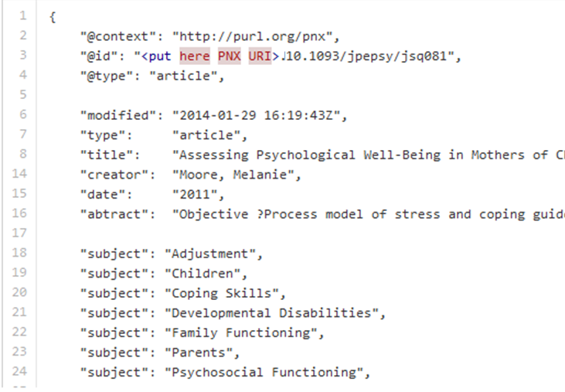
JSON-LD
Notes:
Use embedded Primo Restful Search to gain access to Primo URIs
Use URIs in the application

Slide 15
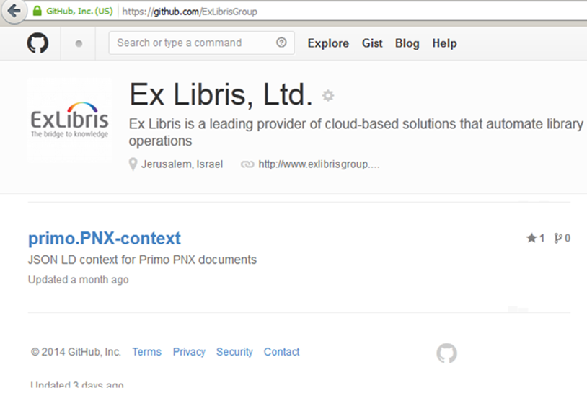
GITHUB
Notes:
Use embedded Primo Restful Search to gain access to Primo URIs
Use URIs in the application

Slide 16
What’s it good for?
The world can use your linked data to create open applications!

Slide 17
Interoperability
In the plan… New Restful Search API that returns URIs
Beta of Primo URI in coming release
Together they can be used to create almost any application based on your linked data
In the plan…
Enhance your linked data using Alma Authority URIs in your catalog
Notes:
Use embedded Primo Restful Search to gain access to Primo URIs
Use URIs in the application

Slide 18
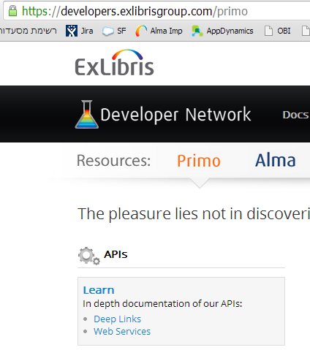
Developer Network
Notes:
Use embedded Primo Restful Search to gain access to Primo URIs
Use URIs in the application

Slide 19
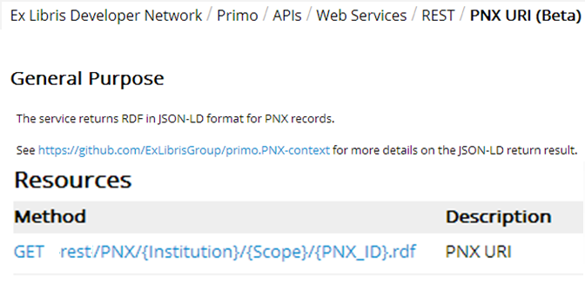
Developer Network
(BETA)
Notes:
Use embedded Primo Restful Search to gain access to Primo URIs
Use URIs in the application

Slide 20
Other goodies

Slide 21
Ex Libris Research
Notes:
Use embedded Primo Restful Search to gain access to Primo URIs
Use URIs in the application

Slide 22
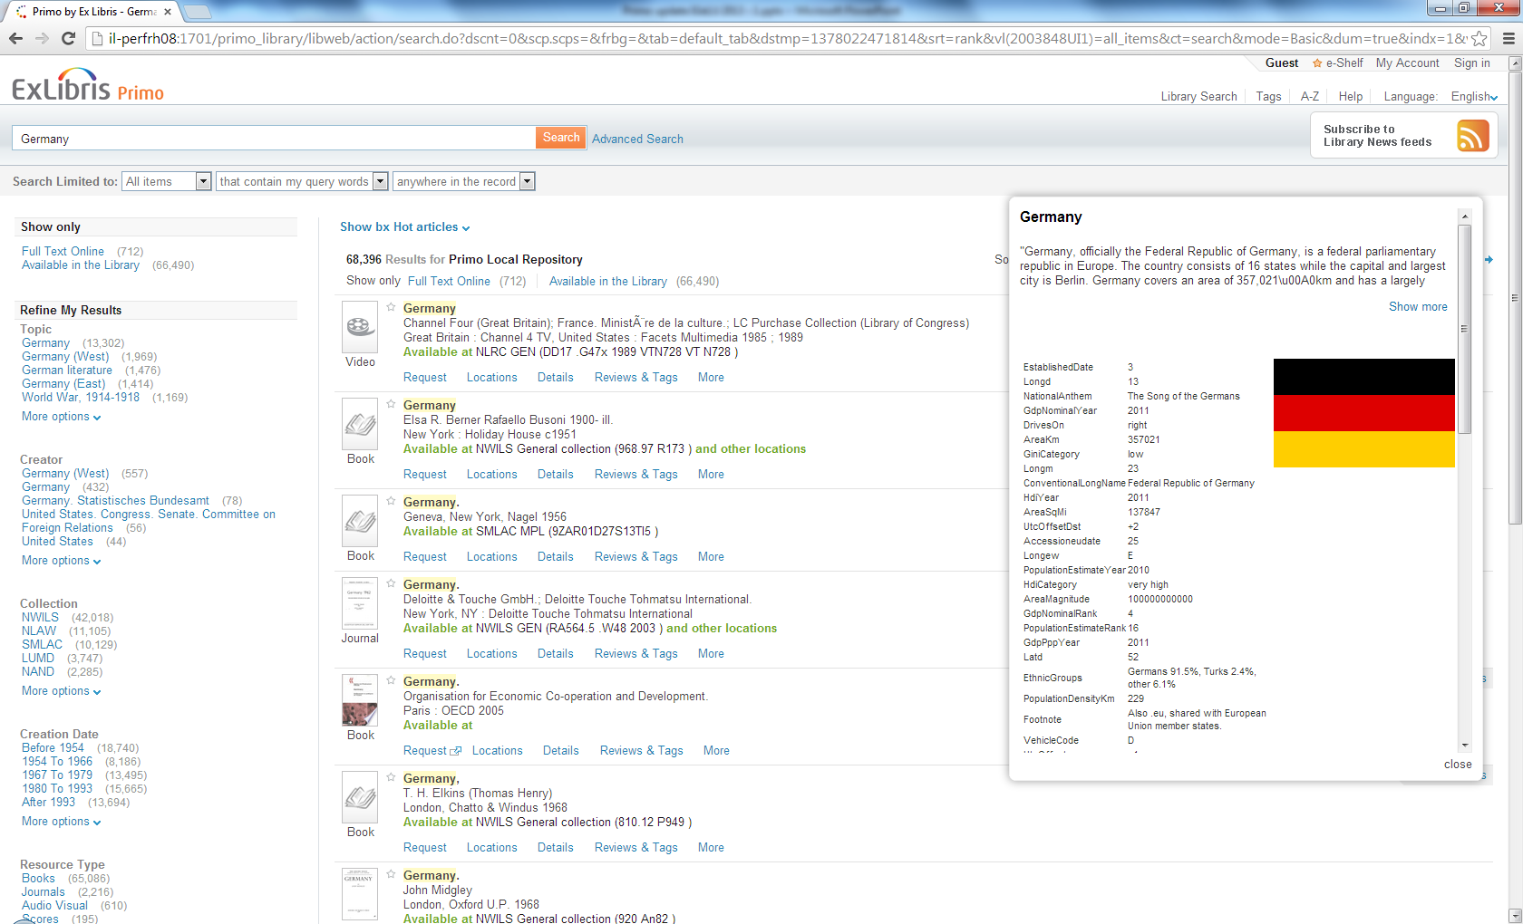
Ex Libris Ltd., 2013 - Confidential

Slide 23
Ex Libris Research
Notes:
Use embedded Primo Restful Search to gain access to Primo URIs
Use URIs in the application

Slide 24
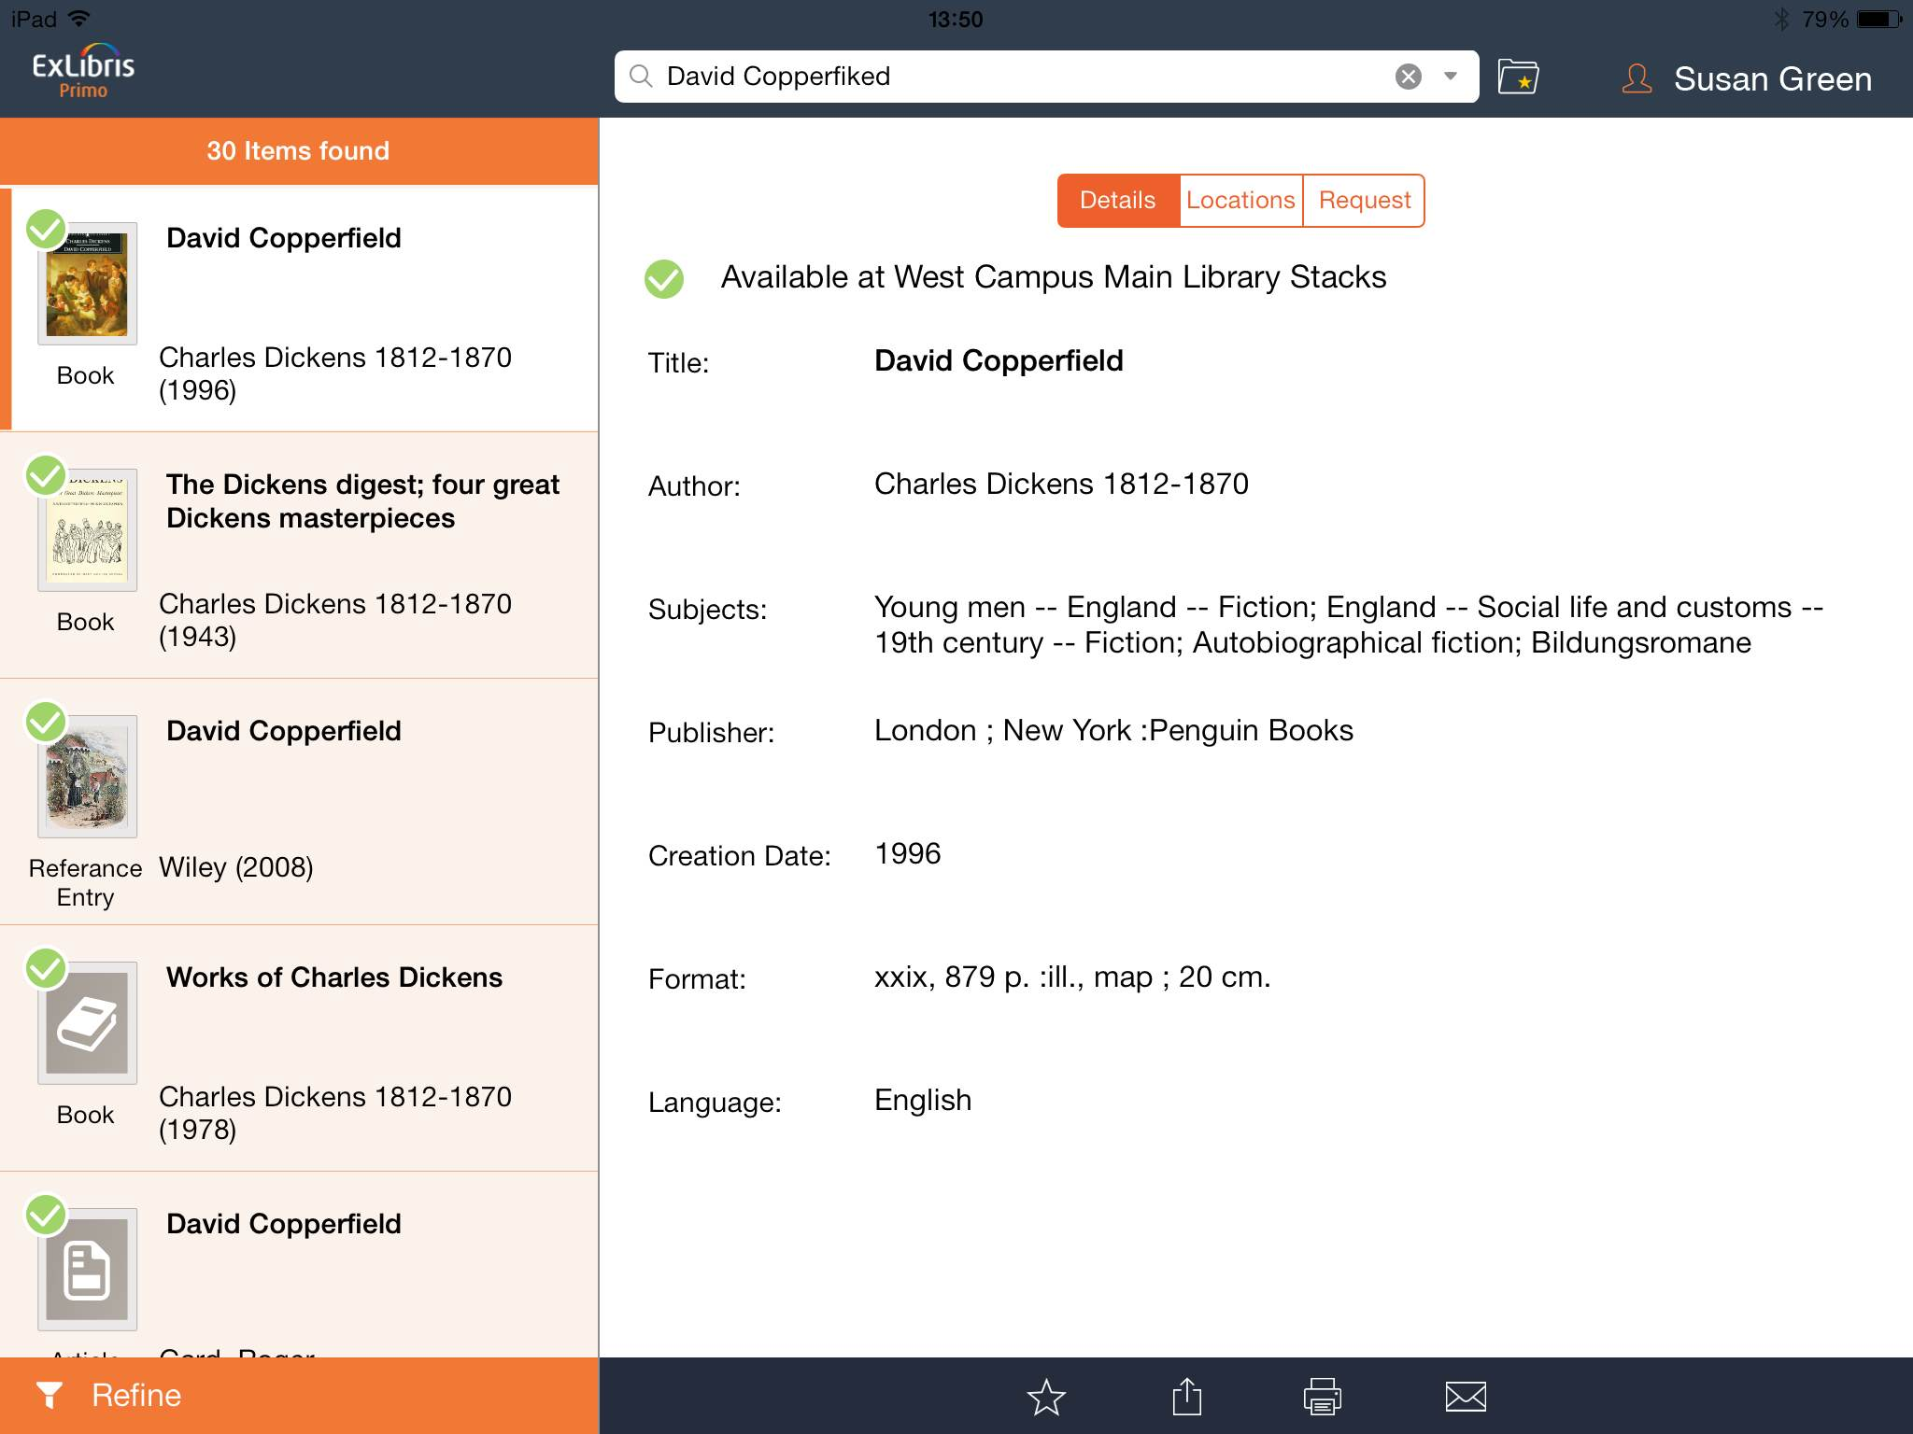
Primo Mobile App
Notes:
Use embedded Primo Restful Search to gain access to Primo URIs
Use URIs in the application

Slide 25
Thank You
Muchas gracias

